Slide 1
WEB3, Session 11
Server-Side Rendering

Slide 2
The more things change … (1999)
I can see a page, but when I interact…
First send data to the server
Then the server fetches data
Then the server creates HTML
Then the HTML is send over my dial-up connection
Time spent on an interaction is too long

Slide 3
… the more they stay the same (2024)
I'm connected to the server, but …
First the scripts are loaded
Then the scripts are compiled
Then the scripts are run
Then the data is fetched
Then the page is rendered
Time to interactive is too long

Slide 4
To SPA and back
The reasons for single-page applications:
  Immediate user interactions
  Distributing the generation of HTML (or HTML DOM)
  Lower bandwidth - the data is smaller than the HTML generated from it
The reasons against single-page applications:
  Difference in computation power of clients
  Higher bandwidth once you factor in all the scripts
  Delayed page loading (SEO)

Slide 5

Where does that leave us?
Single-page applications
  Actual applications
  When most things are about user interactions
Server-side rendering
  When dynamic content is shown
  User interaction is sparse
  Can still allow for user interaction after rendering
Static side generation
  When (mostly) static generation is shown
  Can still allow for user interaction after rendering

Slide 6
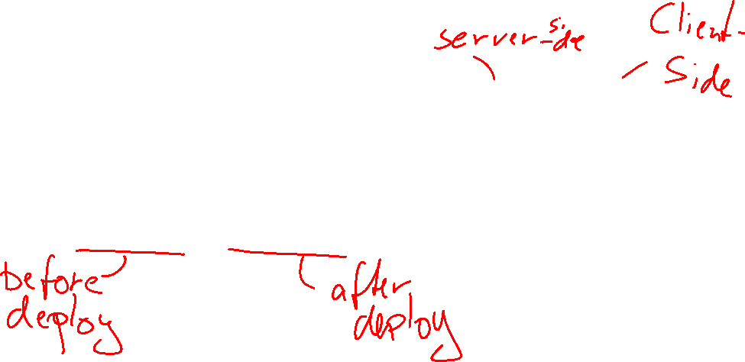
Rendering and user interaction
In this context, rendering refers to the generation of HTML or HTML DOM
  Not what the browser does to display the DOM
It can happen on the server or client side
It can happen on build time or run time
Note, we are not turning of JavaScript
  Re-rendering in the browser can (usually will) still happen
  User interaction can (usually will) still happen

Slide 7
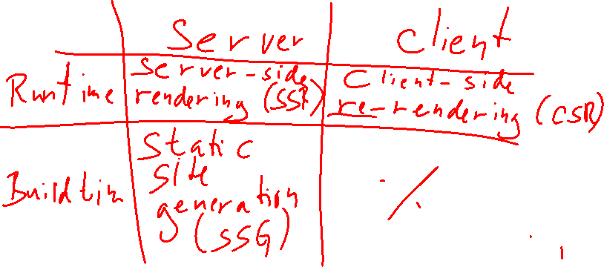
Rendering in SSR/SSG
When?
  Build time
  Run time
Where?
  Server
  Client (browser)

Slide 8
Page generation and data fetching
Static site generation
  Data is fetched at build time
Server-side rendering
  Data is fetched when the page is requested
Client-side (re-)rendering
  Data is fetched when user interacts
  Can also fetch data when page is mounted

Slide 9
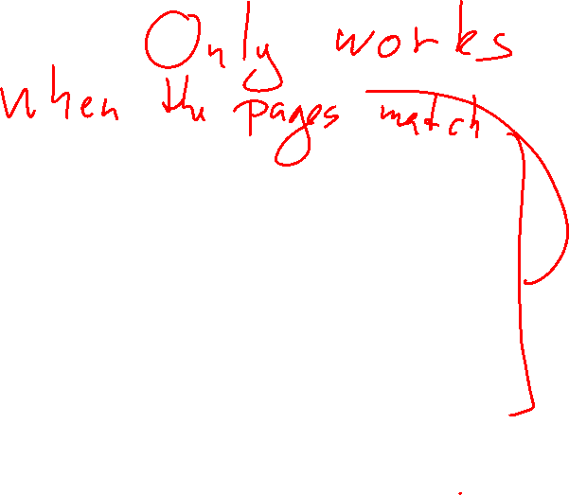
Hydration
In the browser, the Virtual DOM is created using React (when using Next.js)
This is then used to update the page
Your page is now fully dynamic in the browser
It is hydrated
This works whether your page is statically or dynamically generated

Slide 10
Next.js
Probably the most used library for SSR
  (But these things change all the time)
Build on top of React
Uses React's server-side components
Allows both SSR and SSG

Slide 11

Next.js scripts
npx create-next-app@latest
  Creates new next project
npm run build
  Builds the project
npm start
  Runs the project
  Has to be built
npm run dev
  Starts project in developer mode
  Doesn't have to be built
  No SSG - only SSR

Slide 12
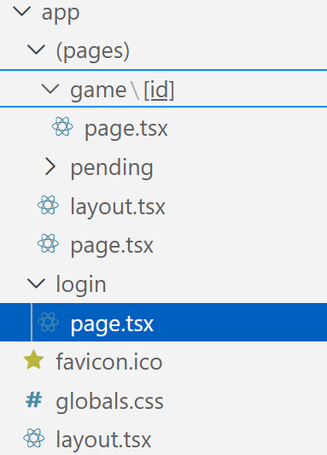
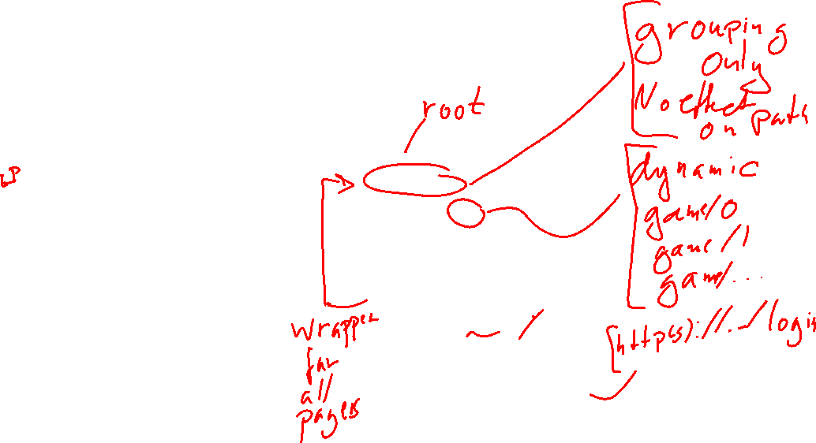
Next.js pages and routes
layout.tsx/layout.jsx
  Wrapers around the page.
page.tsx/page.jsx
  The page you'll find at the path
Static path: / (and /login)
  Default: SSG
Dynamic path: /game/[id]
  Default: SSR
Grouping: (pages)
  Not part of the path

Slide 13

Layout
export default function RootLayout({
children,
}: Readonly<{
children: React.ReactNode;
}>) {
return (
<Page>{children}</Page>
)
}

Slide 14
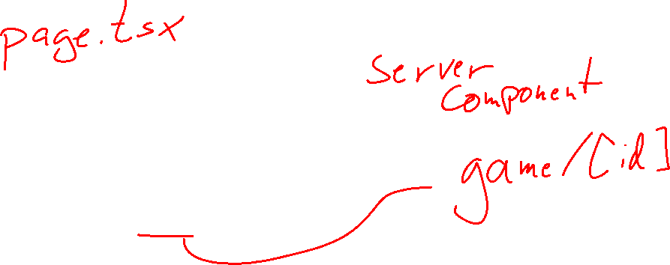
Page
import Game from "@/components/Game"
export default async ({params}: {
params: Promise<{id: string}>
}) => {
const {id} = await params
return <Game game_id={id}></Game>
}

Slide 15
Server and client component
Server components are rendered only on the server
  You can still manipulate the DOM in pure JavaScript, but not React
  You cannot use any hooks (use…)
  You can use async/await
  Default, but can also be marked with 'use server' in the first line
Client components are rendered on both server and client
  You can use all hooks
  You cannot use async/await (except in local functions - like useEffect)
  Marked with 'use client' in the first line
  Does not trigger dynamic rendering

Slide 16
A Client Component (excerpts)
'use client'
export default function Login({proceedTo}: {proceedTo: string}) {
const [player, setPlayer] = useState('')
function login() {…}
return <>
Username: <input value={player}
onChange={e => setPlayer(e.target.value)}/>
<button disabled={!enabled} onClick={login} >Login</button>
</>
}

Slide 17
Dynamic and static rendering
Dynamic rendering (SSR)
  Takes place at runtime
  Generate the page with fresh data
  Triggered by
    A dynamic route: /game/[id]
    Using run-time APIs: cookies, headers, searchParams, params
Static rendering (SSG)
  Take place at build-time
  Generate data-independent pages (or with stale data)
    But can be re-validated
  Triggered by static route and no run-time APIs

Slide 18

Forcing dynamic/static rendering
Forcing dynamic rendering (for non-dynamic paths):
  Somewhere in the file:
  export const dynamic = 'force-dynamic'
Forcing static rendering for dynamic paths:
  Export this function:
  export async function generateStaticParams() {
  const res = await fetch('https://localhost:8080')
  const games: Game[] = await res.json()
  return games.map((post) => ({
  id: post.gameNumber
  }))
  }

Slide 19
Using Web Sockets
All web socket code has to be in client components
The best way is to create the web socket connection in useEffect
Close the connection in the clean-up function
Important: If you update a state (from useState) in the web socket, you have to use the functional version of the setter (see code later).

Slide 20
useEffect
A React hook - is given a function
Called the first time the component is rendered
Called again based on an array of values:
  If no array is given (undefined): Called on every re-render
  If an empty array is given: Only called the first time
  If a non-empty array is given: Called when any of the values have changed
Clean-up function: Returned from the useEffect function

Slide 21
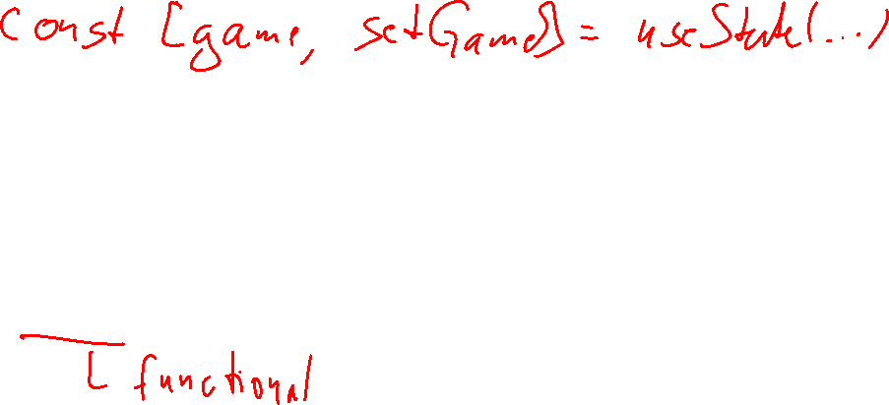
Web socket in Next.js client component
useEffect(() => {
const ws = new WebSocket('ws://localhost:9090/publish')
ws.onopen = () => {
ws.send(JSON.stringify({type: 'subscribe', key: 'move_' + game.gameNumber}))
ws.onmessage = ({data}) => {
const {message}: {message: MoveMessage} = JSON.parse(data)
setGame((game: Game) => applyMoveMessage(message, game))
}
}
return () => { if (ws.readyState === WebSocket.OPEN) ws.close() }
}, [game.gameNumber])

Slide 22
Advice and pitfalls

Slide 23
Be aware of both server and client
Which data is available on the server?
  How is it used to render the page?
Which data is available on the client?
  Especially: Does the client and server agree?
Remember that a client component is rendered on the server first
Disagreement between server and client may result in
  At best: Hydration errors, triggering a re-render
  At worst: Infinite re-renders

Slide 24
Use cookies to share data between server and client
For login tokens, session ids and similar
On a dynamic page:
  Use the next.js cookies() API
On a static page:
  Use whatever you would use in JavaScript
  js-cookie is popular

Slide 25
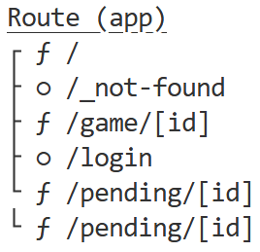





Be aware of static vs dynamic generation
Plan for which pages are static or dynamic
Use npm run build to check
Force dynamic if you need to
Failure might have you server stale data
Pitfall:
  npm run dev is always dynamic
  You need to use npm run build + npm start to test

Slide 26

State management
Global management is incredibly hard
  Since this runs on both server and all clients (see this)
My approach:
  In a server component:
    Get initial data
    Provide the data to the client component wrapper
  In the client component:
    Create a state using one or more uses of setState()
    Create a context with both the state values and the necessary setter(s)
    Use useContext to get the state
    Use and set the state as needed

Slide 27
Conclusion
Use Next.js for SSR and/or SSG
  (Alternatives: Nuxt.js, Quasar, ...)
Be aware of which parts are dynamic and which parts are static
Test in both developer and production mode

